Slide 1
Digital Archives
Notes:
Remember to show them how to get to the databases for 19th century british periodicals and crime, punishment, etc. Library.wlu.edu -> databases.
Open Access
Paywalled
Sustainability
Metadata
Interoperability
NINES
Peer Review
Archives contain priorities

Slide 2
Why TEI?
A good in itself.
To prepare things for digital editions.
To curate content for archiving.
Notes:
Interpretive act – we get something out of thinking responsibly about texts
Preparing texts for study. Those norton anthologies you read? Work goes into them? This kind of work.
But they also play into the responsible aggregation of content like what we’ll be seeing today. The Archives you’ll be working with.

Slide 3
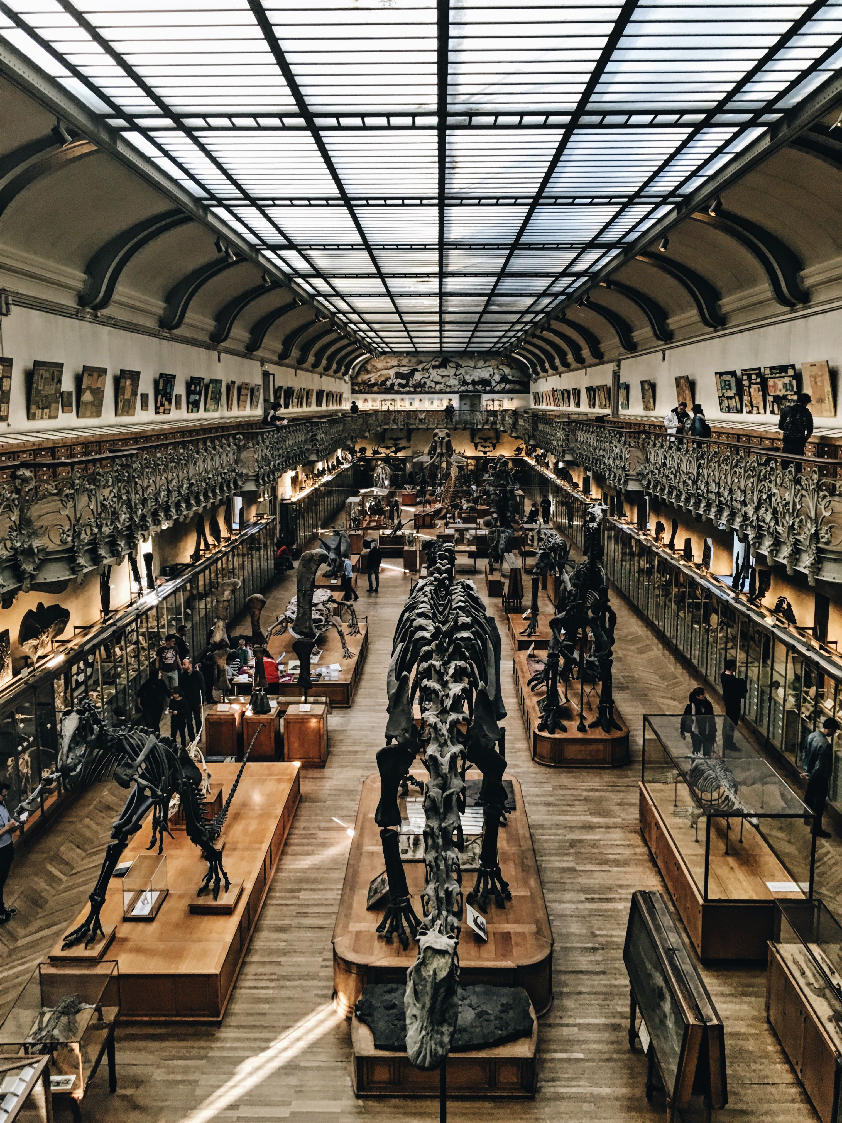
Notes:
What are some elements that characterize a museum? Not quite the same thing as an archive, but we’ll use it as an approximation for the kinds of things that we’re interested in.
Try and point them towards –
Curation – selecting what is important and highlighting it
Preservation – maintaining the things that you’re looking at
Education – outreach, etc.
Access.

Slide 4
Distinctions
Digitized vs. Archived
Digital Collections vs. Digital Archives
Anything can be digitized and put online.
Does not make it an archive.
Archives entail three properties:
Curation, Preservation, Access
Notes:
A few distinctions.
Simply digitizing something does not make it an archive.
Digital collections – a subscription to a journal, say. Can go away! What if your library stops subscribing to it.
A digital archive is more permanent and entails long-term preservation plans. Guiding questions: how can these materials be presented in the best possible way for the longest time possible?

Slide 5
Curation
Careful selection, organization, and creation of metadata for a series of objects.
Design reflects priorities
Design reflects the research goals of your archive.
Metadata reflects priorities
Notes:
When you’re looking at your archives, you should be thinking about these categories.
How do the sites you’re working with reflect different types of curation? Here are some ways.
Think about web design.
Think about metadata. Each of them reflect different priorities. Do we remember what metadata means?

Slide 6
http://web.archive.org/web/20100813142028/http://havenworks.com/
Notes:
An example. Might not think you can identify these elements, but take a look!
What is this site about? How does it reflect what its priorities are?
Might be useful to work from bad to good. Push towards:
Information hierarchies, categories, links, images, etc. Aesthetics reflect the things that the archive finds important
This is a glut of information as an attempt to provide information. Does it work?

Slide 7
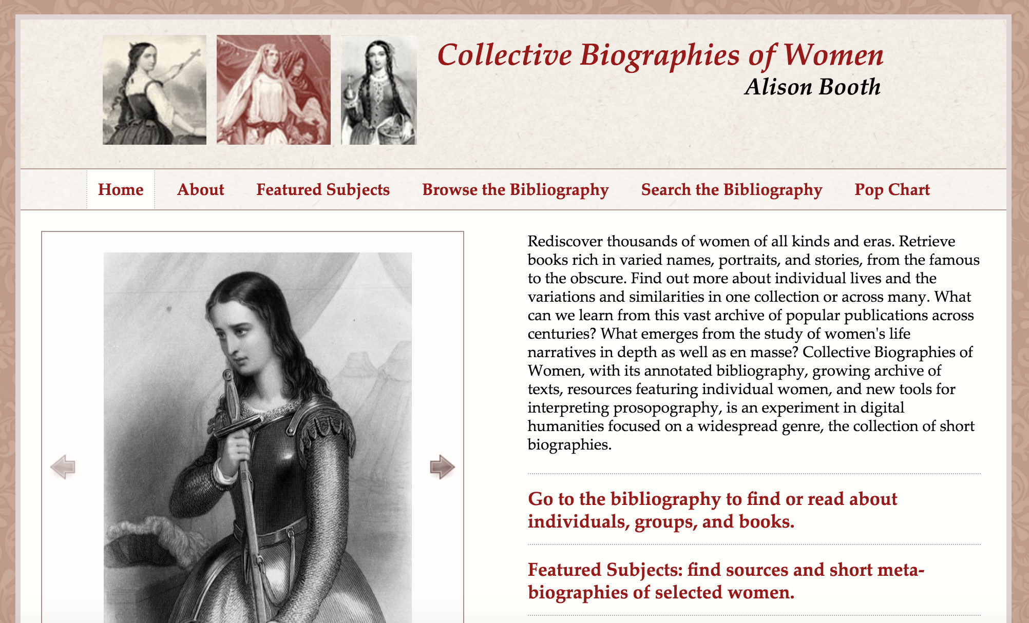
Notes:
What about this site? Even without any real description of the site, what do we know about the project?
1. It’s interested in women
2. Insterested in stories about women.
3. Featured suggests curation
4. Browsing suggests a lot of information.
5. Can browse and search

Slide 8
womensbios.lib.virginia.edu/
Notes:
We can see if we look at the actual text that we’re on the money. It’s a project that is interested in recovering histories of lifewriting about women as means of recreating an archive that they see as lacking.

Slide 9
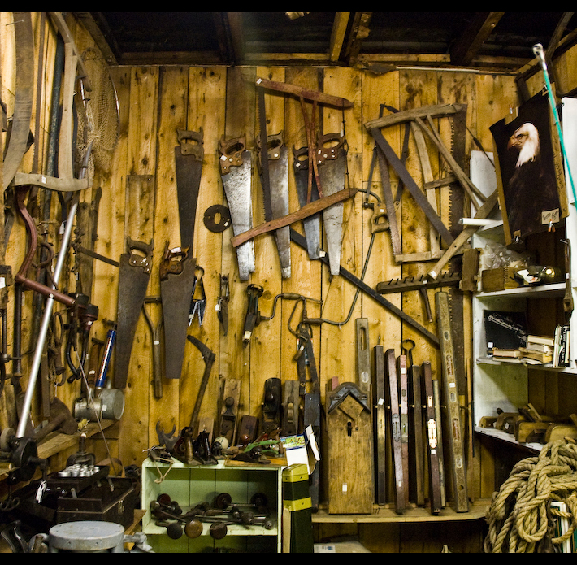
Content Models
Museum
Shed
Notes:
The thing on the right could be said to fulfill a lot of the same functions as a museum/archive. They both collect things, preserve them from the elements, and provide access to them. How does it differ?
Organization
audience
Maintenance
Access
Free vs not

Slide 10
Museum
Shed
Organized
Wide audience
Clearly Maintained
Educational
(Sometimes?) Free
Disorganized
Audience of one
Not maintained
Functional
Free

Slide 11
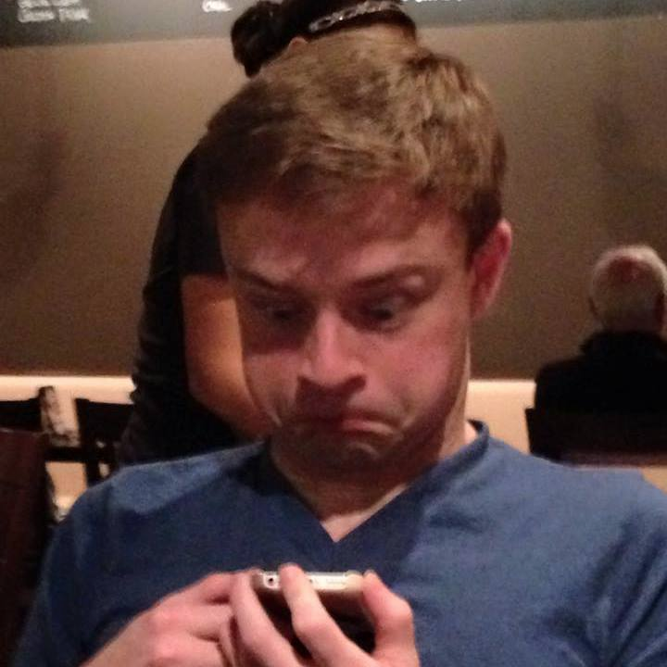
Notes:
Some more thoughts on digitized collections -
This is a digitized representation of me. It is not, by default part of an archive.
It’s a representation of an image in the world. But we would need to do some work to make it part of an archive.

Slide 12
Archives Contain Metadata
Metatdata: data about data
Brandon is the object.
By giving him metadata we can archive him in a database of persons.
Not the only element of archiving, but an important part.
Notes:
But we could make it part of an archive with a few more steps.
TO REVIEW

Slide 13
Notes:
So what are some metadata categories about me? What are some metadata categories for the picture? Be nice.

Slide 14
Metadata for our Person
Id: 1111
Name: Brandon Walsh
Height: 12 Feet Tall
Face: Pearish
Photo:
Notes:
You’re all wrong.

Slide 15
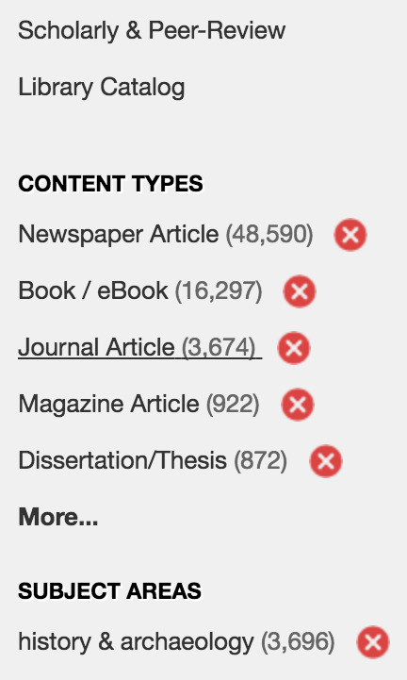
Metadata Cont.
Metadata is an interpretive decision.
Why doesn’t this search for
“Brandon Walsh”
make sense?
Looking at metadata for an
archive can tell you about it.
Notes:
Here I have done a library search for Brandon Walsh in our catalog. What doesn’t make sense about it? What kinds of things are they expecting you to search? Says something about their institutional mission.

Slide 16
Preservation
Material concerns: servers need to be maintained.
Redundancy: backups on backups on backups
Changing software standards: have any of you had an app that stopped running after updating your computer?
Notes:
One thing about books – they tend to be around. You have to maintain them, but the physical technology is still accessible. Not so for technology.
When you put something online you have a range of ways in which to do so. Filetypes, file qualities, hardware requirements. All of these can potentially be destructive down the road.
They also all cost money. It costs to keep the lights on.
So when looking at an archive: try to figure out what steps they have taken while putting the site together. Are they thinking about the future at all? Do they describe any sort of preservation plan?
The process of uploading something to a digital archive entails as many questions about sustainability and the future as any special collections rare books room does. You just have to get used to finding the right questions to ask.

Slide 17
Standards
Just like TEI was a standard, there are metadata standards: Dublin Core, MARC, etc.
These ensure that your work is interoperable with that of other researchers around the world.
But they’re all slightly different.
Notes:
One example that I mentioned yesterday.

Slide 18
Metadata Variations
Brandon
Brandon Walsh
Walsh, Brandon
Brandon M. Walsh
Brandon Michael Walsh
BMW
B. Walsh
Notes:
All different variations on the same kind of name. And the more variation you have, the more difficult it is to store things, use them in the future, and archive them.
Take note of the format of the information in your particular archive. Not just about what information they’re storing about particular things but also how they’re storing them.

Slide 19
Access
Aura: the unique object that exists in a particular place at a particular time.
Walter Benjamin
When you visit a physical archive, you are gaining physical access to a thing.
Digital archives distribute that access across a network.
Notes:
More access? Cheaper? Freer?

Slide 20
Access
Not all digital access is created equal.
Open access: materials will be provided without any financial restraints.
Paywall: the thing you run up against when you need a subscription to see something.
Former might seem best, but how do you fund something for free?
Notes:
One last note on access. Open access vs paywall.
You might try to determine what copyright restrictions are placed on the archive’s materials. How is the site funded? Is the library paying tens of thousands of dollars for you to access it? Won’t be able to find answers to all these questions, but they can help point you in good directions.

Slide 21
In Conclusion
Library catalog: a lot of hidden work.
Digital archive: a lot of hidden work.
Using these tools, you can start to see and think critically about the archives you use?
Who put this archive together?
How?
Why?
Notes:
Really about hidden labor.
Using these topics you can start to think more critically about the kinds of things you’re using on a regular basis.

